Slide 1
Presentation Video
https://youtu.be/pDrvD1Wry7c
Deployed Web-App
https://haus-e1dc4.web.app/

Slide 2


at haûs ,
we commit to putting a roof over û

Slide 3



Our Problems
Difficult Search Process
Financial
International Student
Support Network
WADII G8T3 | haûs .
Hard to finalise on a suitable accommodation
Limited financial capability
Lack of support network

Slide 4
Our Solution
Quick Decisions
Readily Available Information
Financial
Support Network
Enhanced Security
& Communal Living
WADII G8T3 | haûs .
Short grace periods for decision making
Limited financial capability
Lack of support network

Slide 5

Datastore
WADII G8T3 | haûs .
Firestore Database
Cloud Storage (images)
Deployment (additional)

Slide 6



Javascript
Vanilla Javascript
VueJS CDN
Event Listeners
DOM Manipulation
Entering data from Firebase into HTML
@click functions in order to read and manipulate data
jQuery
Determine height of map and its parameters while scrolling
Dynamic Viewing Page
WADII G8T3 | haûs .

Slide 7


Styling
CSS
Bootstrap
Div Styling
Text Styling
Heart / Bookmark Animation
Grid - System
Cards
Navigation Bar

Slide 8

API used
WADII G8T3 | haûs .
.
Dynamic Maps
Allow users to reference map while viewing listings

Slide 9


Others
WADII G9T3 | haûs .
GitHub Repository
Collaboration
History / Progress Tracking
Authentication
Ensure validity of users
Security of potential tenants

Slide 10
Our Pitch Video
IDP G8T5 | haûs .

Slide 11
03
Empathy
IDP G8T5 | haûs .
Notes:
We move on to our Empathy Process. After much consideration, we have decided to focus only on the tenant flow to ensure it is the best that it can be, thus taking out the landlord flow from the previous iteration.

Slide 12

Our Primary Persona
IDP G8T5 | haûs .
Goals & Needs .
before arriving Singapore
near school
safe environment
fully furnished home
welcoming community
Pain-Points .
short grace period
a lot of admin work
cluttered listings
pushy agents
language barrier
Nicole (20 yo)
Notes:
Our user needs and painpoints remains the same and thus the Primary Persona, as we believe, should stay the same.
Once again we focus on an international student, who requires a home and has to secure it before arriving Singapore. This living environment has to be convenient and comfortable whilst also coming with a safe and welcoming community. However, in search of this, she experiences a tedious process that come with short decision grace periods and agents who are hard to communicate with.

Slide 13
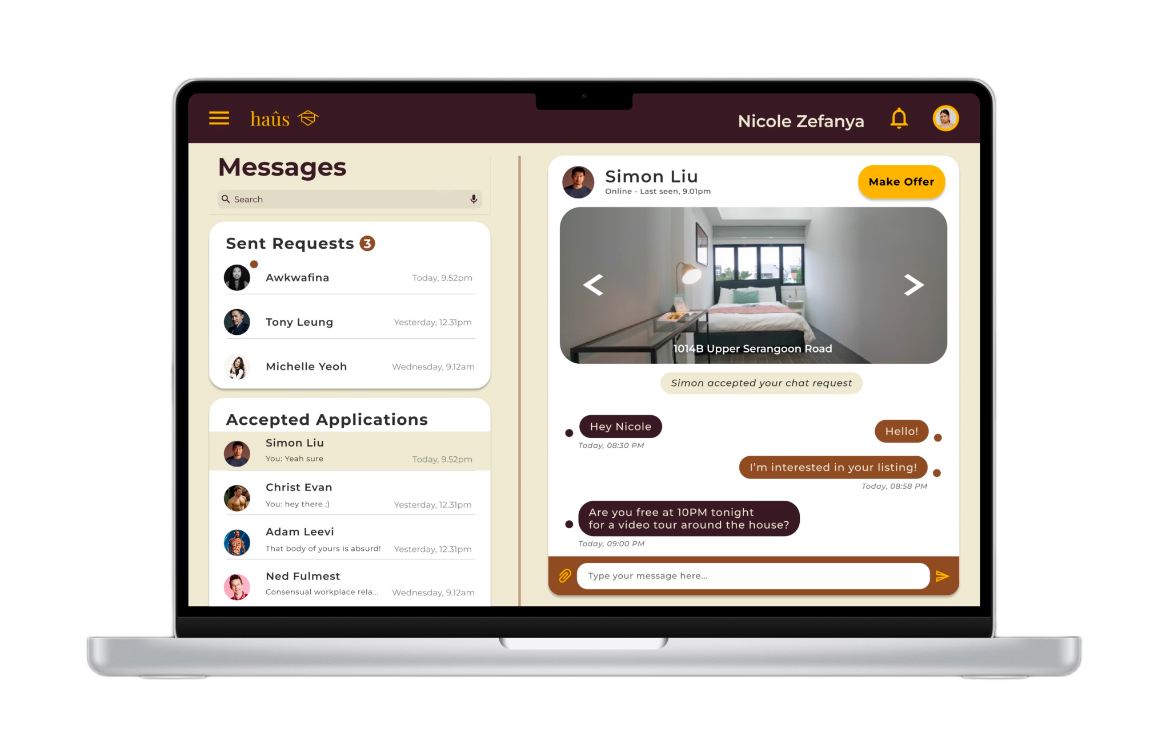
Our Main Fixes (1 of 3)
IDP G8T5 | haûs .
01
Fix inconsistent chat interface
Separated the chat sidebar from the navigation sidebar
Notes:
To better improve our users’ experience on our Web-Application, we’ve decided to make changes based off of our peer heuristic evaluations.
Firstly, we have fixed the inconsistent chat interface by Separating the chat sidebar from the navigation sidebar. Our instructors had actually suggested a minimized chat box at the bottom right of the page, however, we decided that a larger interface would help users focus on the chat and this would not clutter the home page.

Slide 14
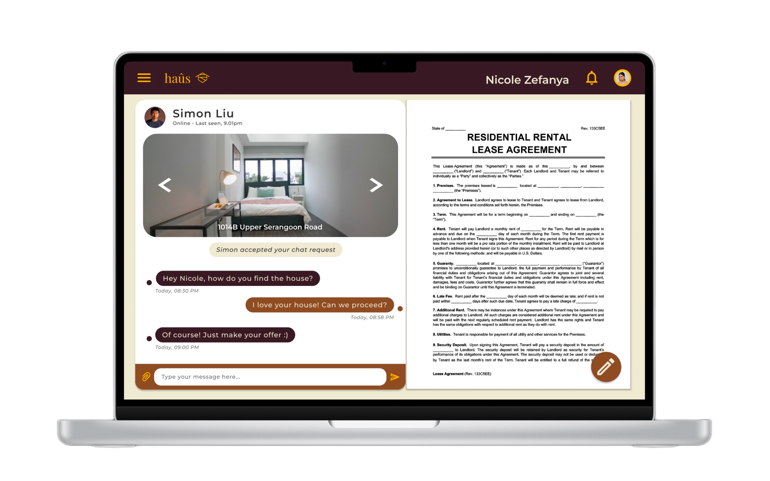
Our Main Fixes (2 of 3)
IDP G8T5 | haûs .
02
Allow edits to contract signing
Added an edit button in order to allow users to edit an already filled in contract.
Notes:
Following this, we have also allowed users to edit their already filled in contracts. This will ensure that users will be have a smoother administration process without having to panic after realising a mistake.

Slide 15
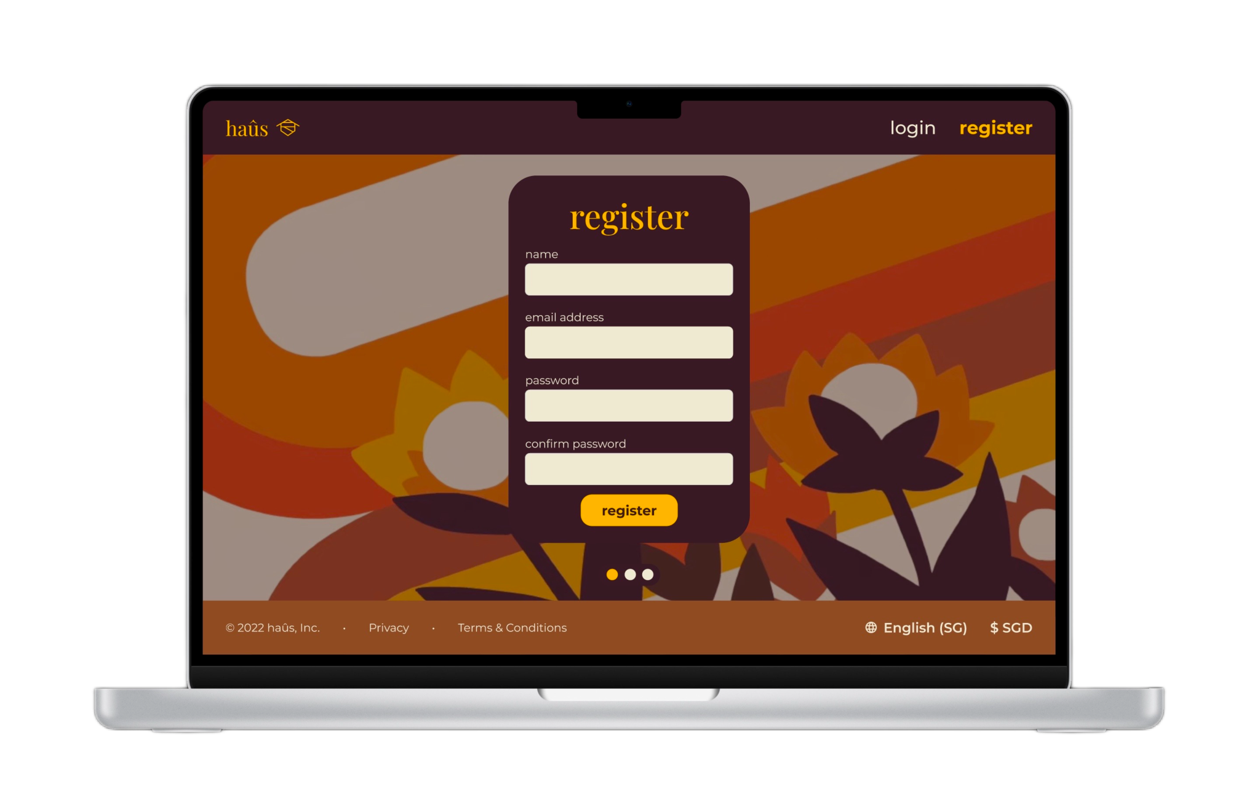
Our Main Fixes (3 of 3)
IDP G8T5 | haûs .
03
Misleading Registration Page
Addition of a register button on the register page
Notes:
The last major change we implemented was at the start of the user journey. Our team designed a register flow that is intuitive and easy to navigate through, allowing users to join the haus community in a smooth and convenient manner.

Slide 16
04
Prototype
IDP G8T5 | haûs .

Slide 17
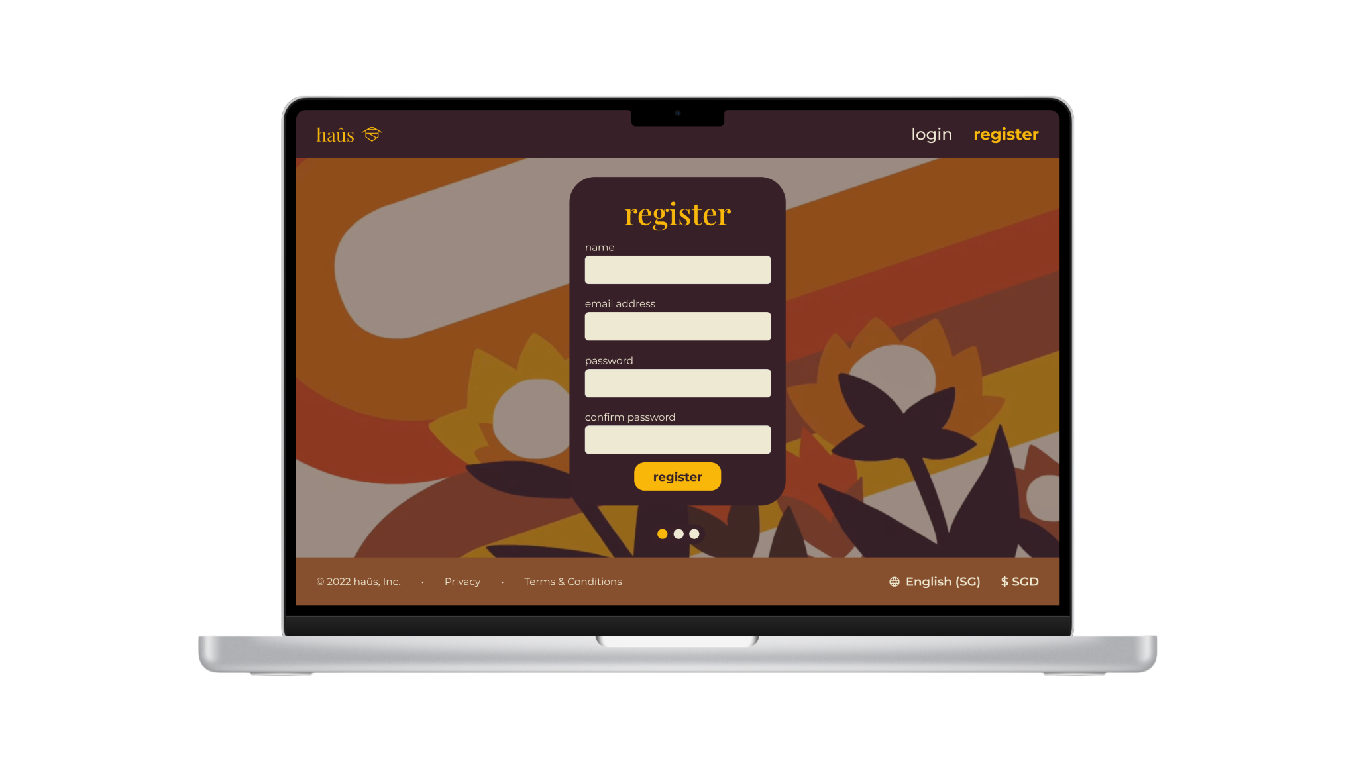
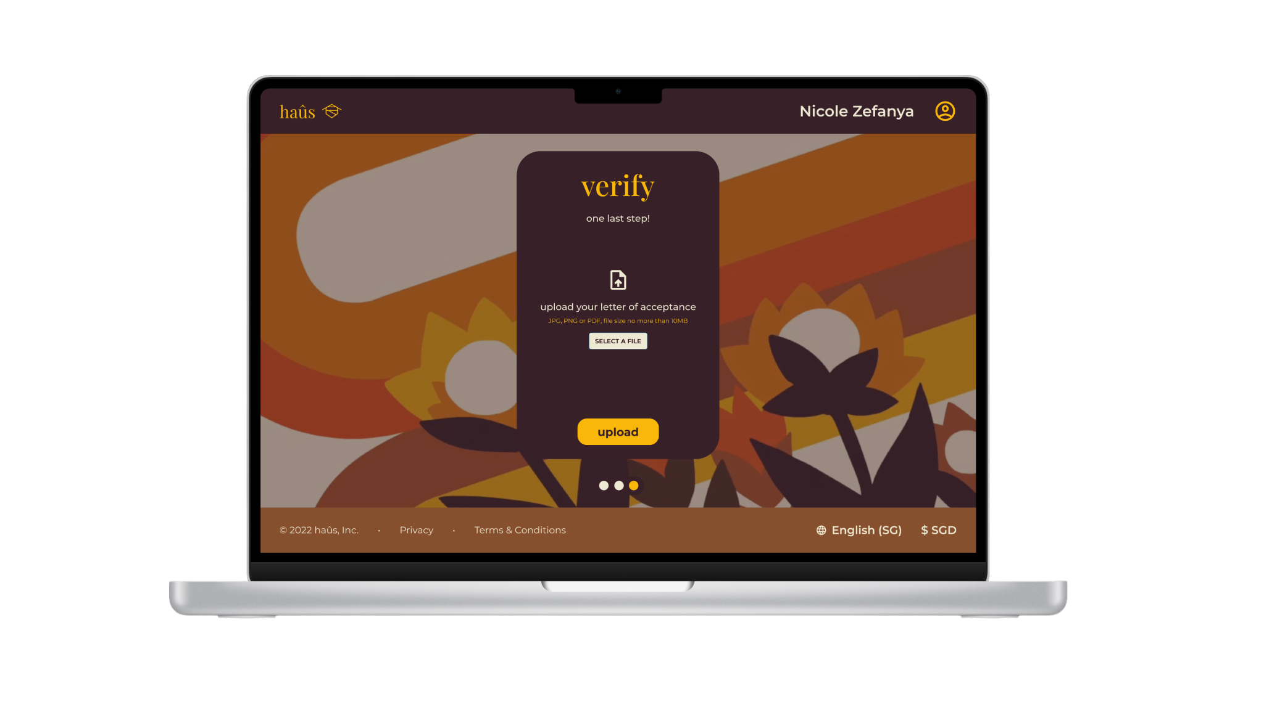
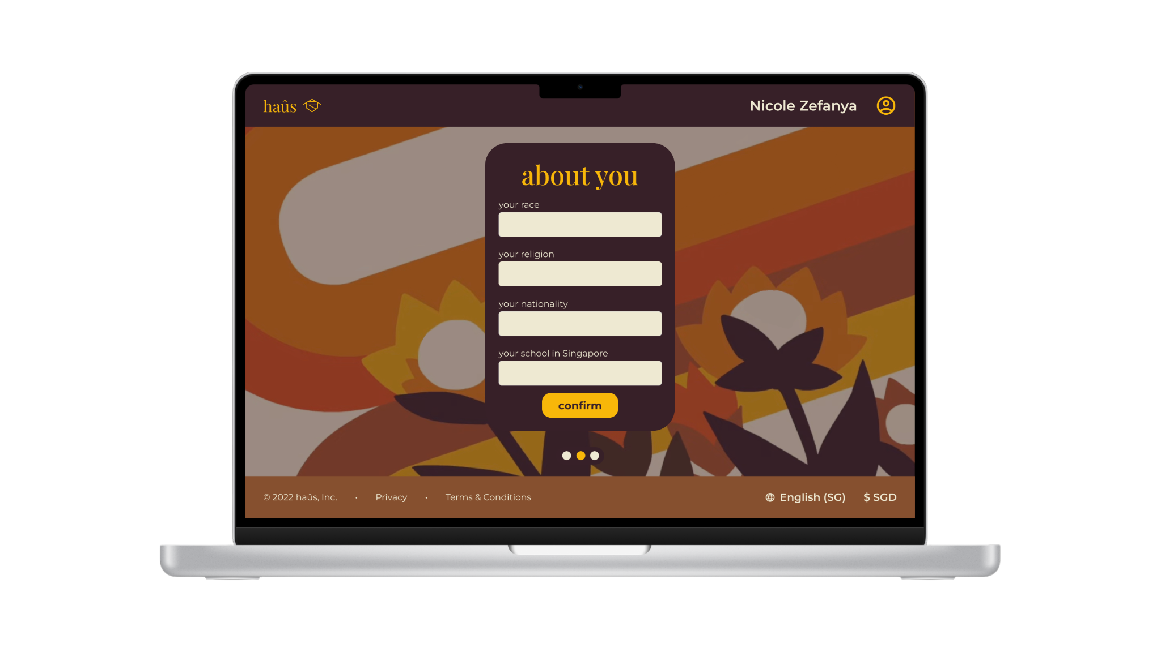

Register Page (Verification)
IDP G8T5 | haûs .

Slide 18
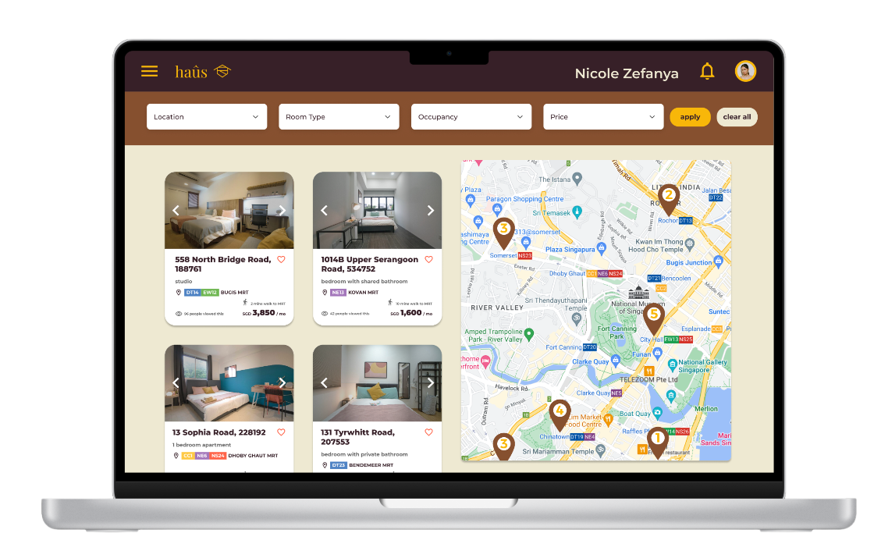
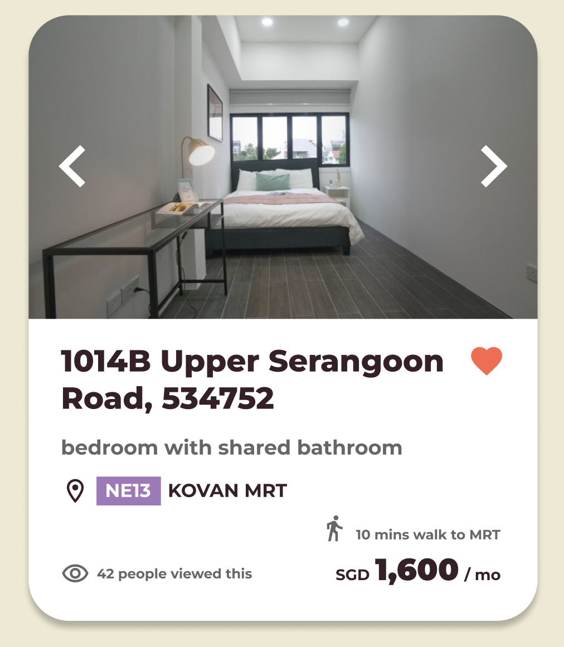
Real time update on viewers
IDP G8T5 | haûs .

Slide 19
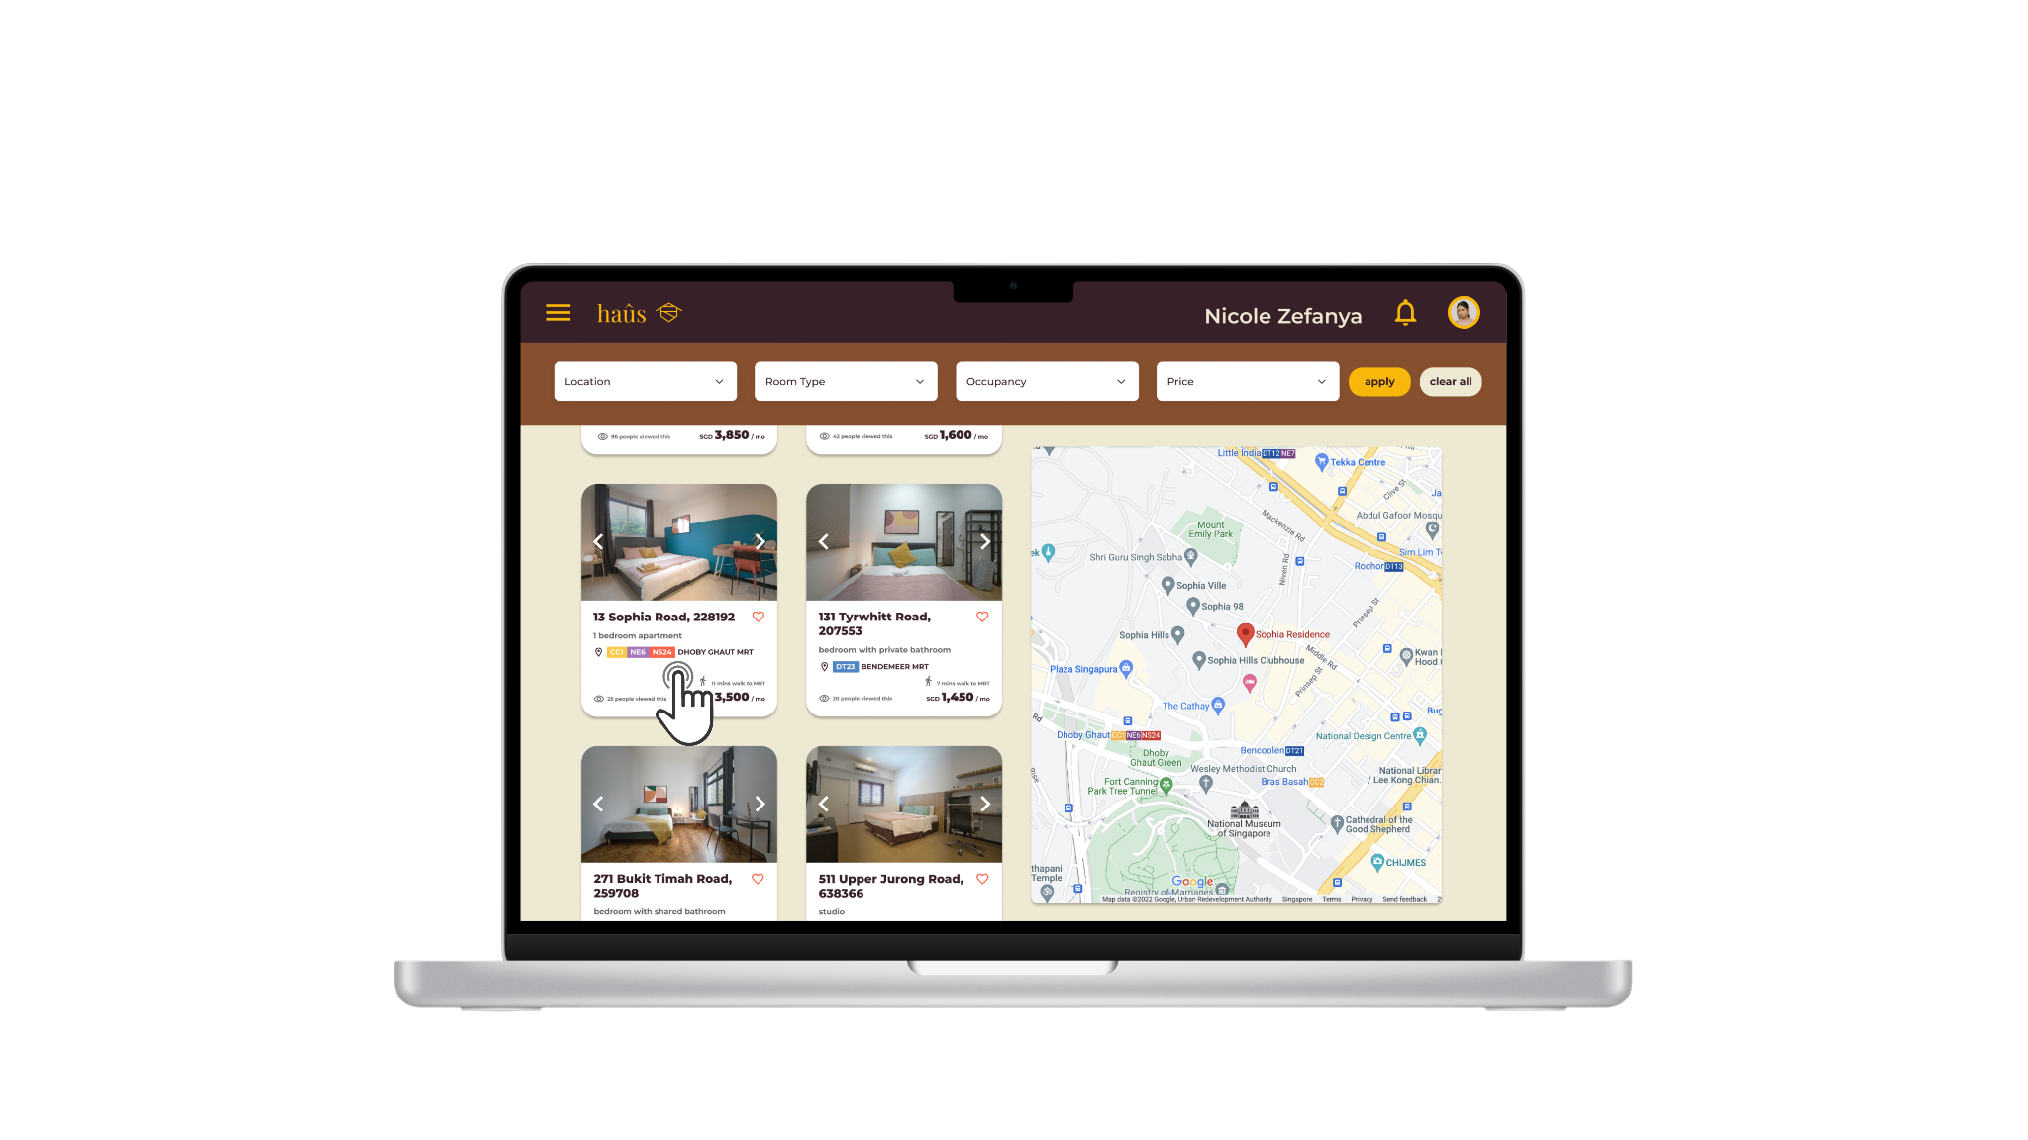
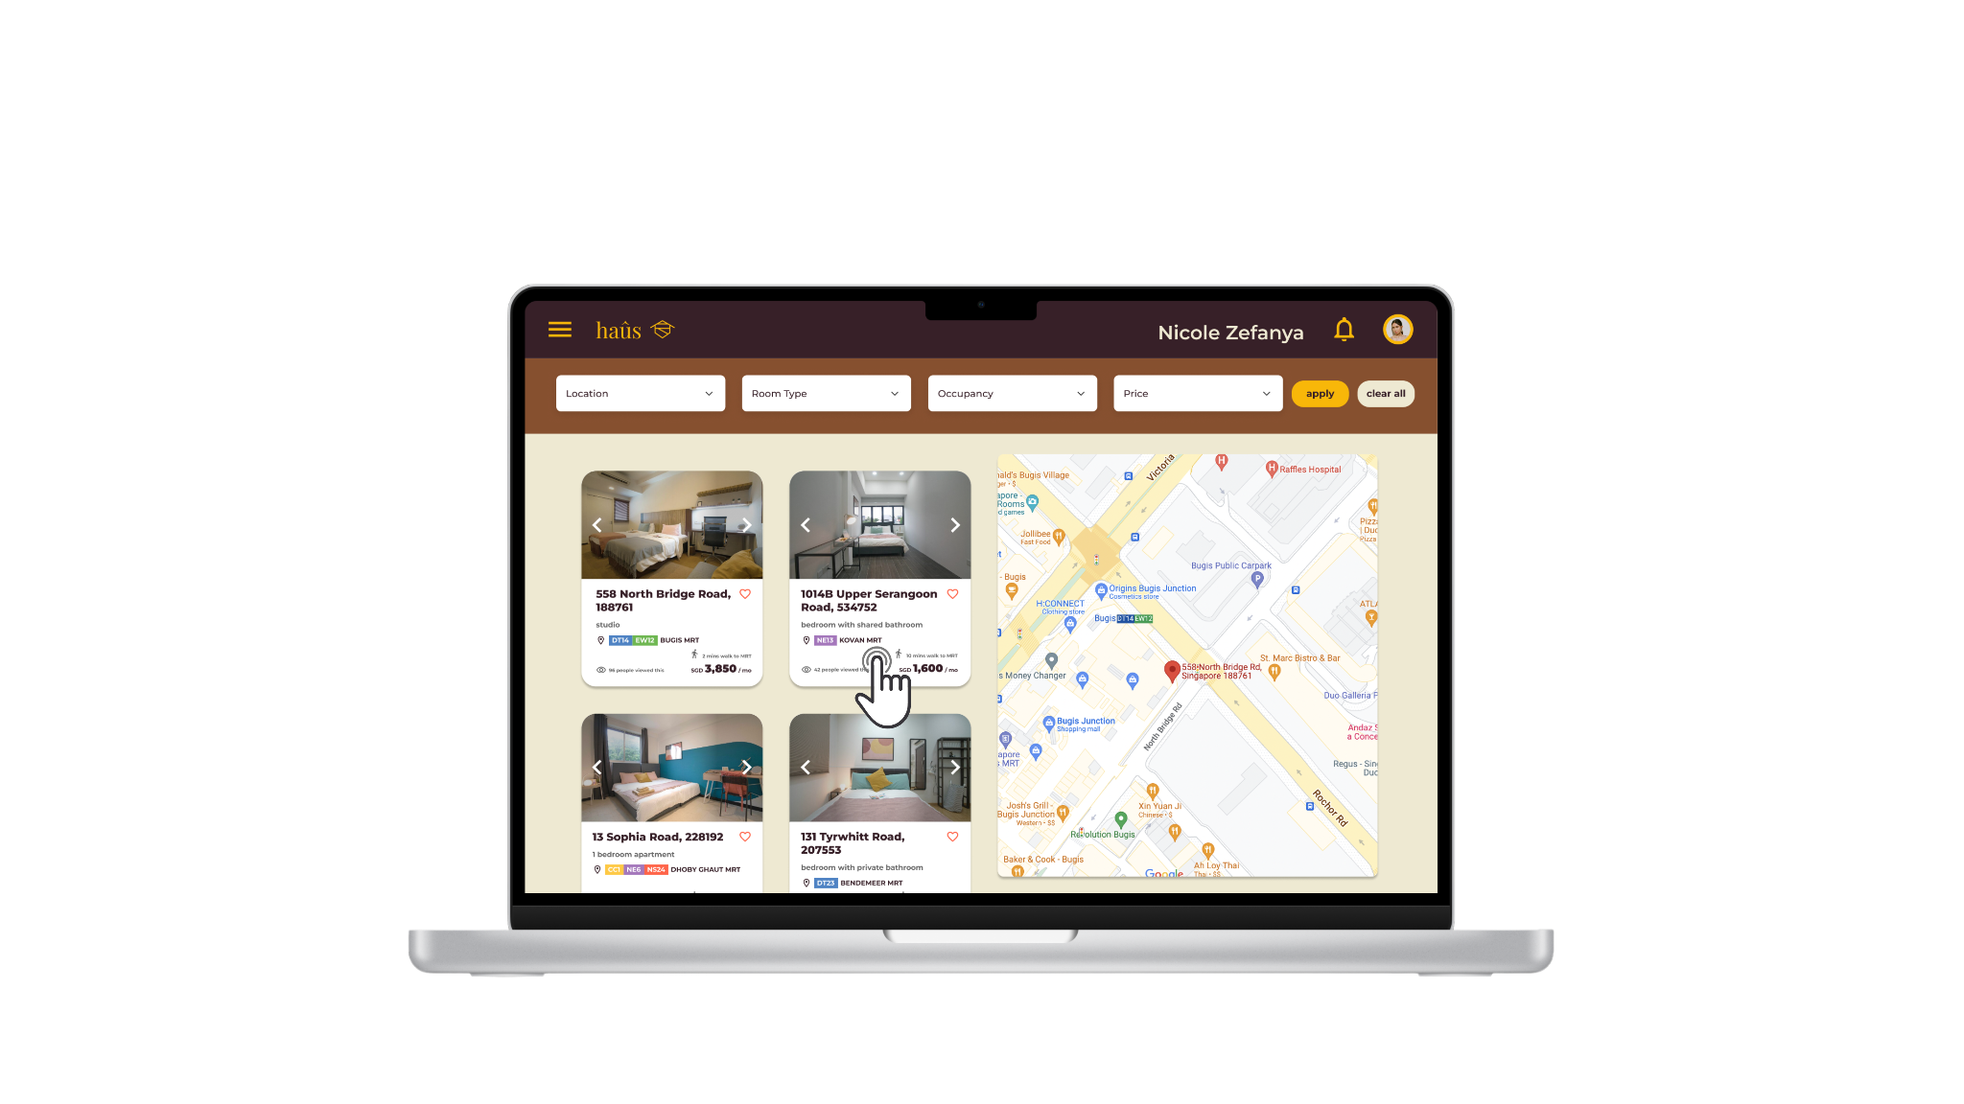
Interactive map
IDP G8T5 | haûs .

Slide 20
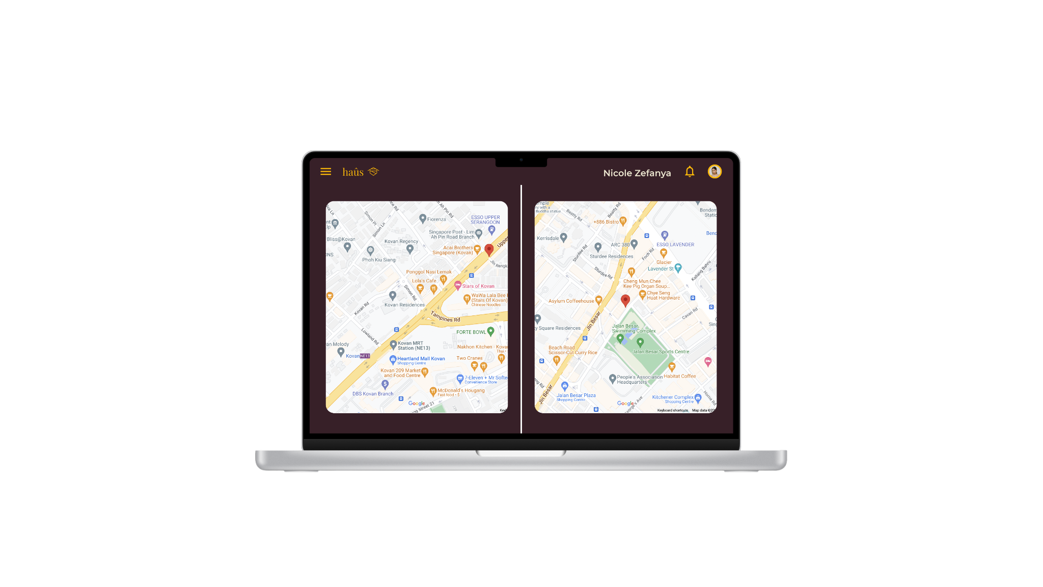
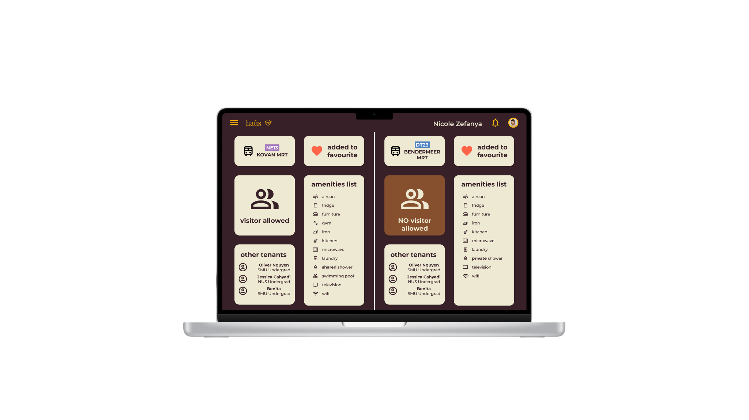
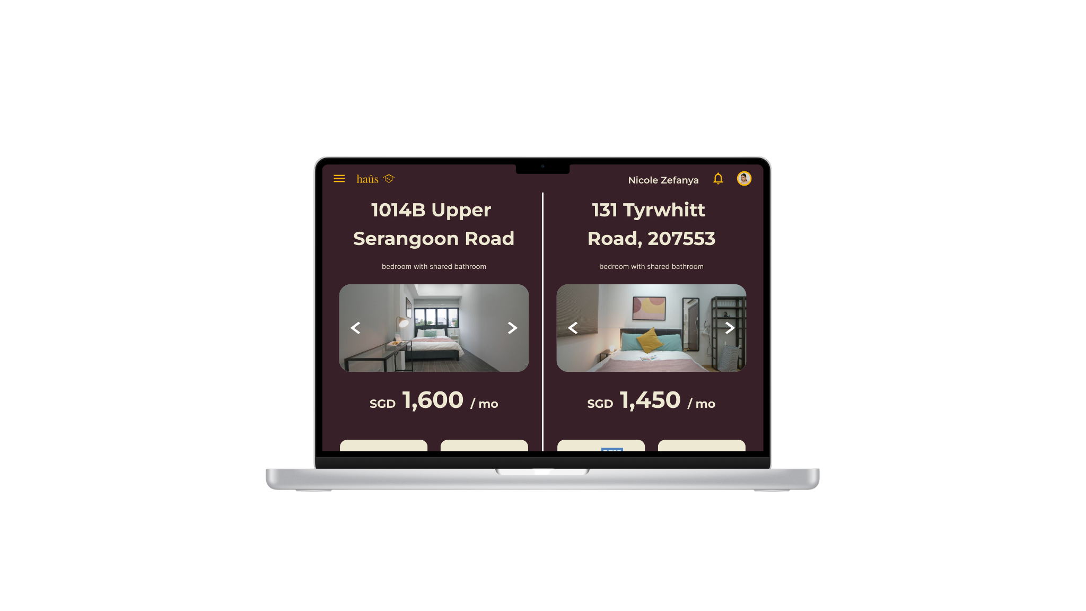
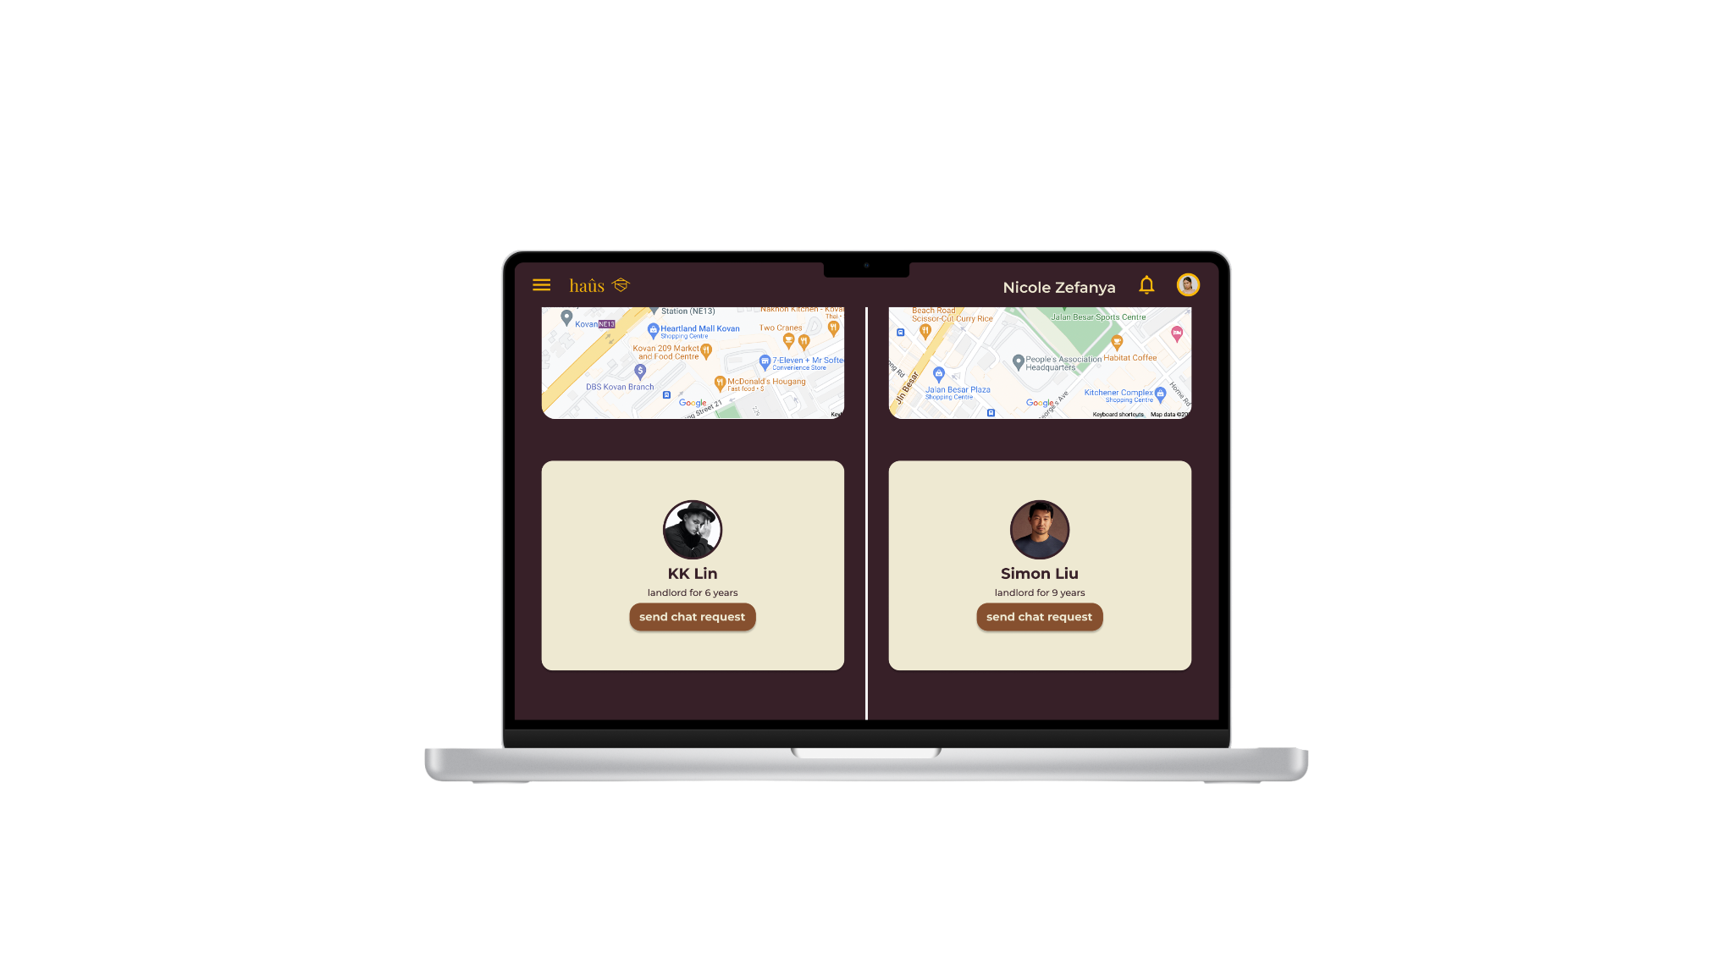
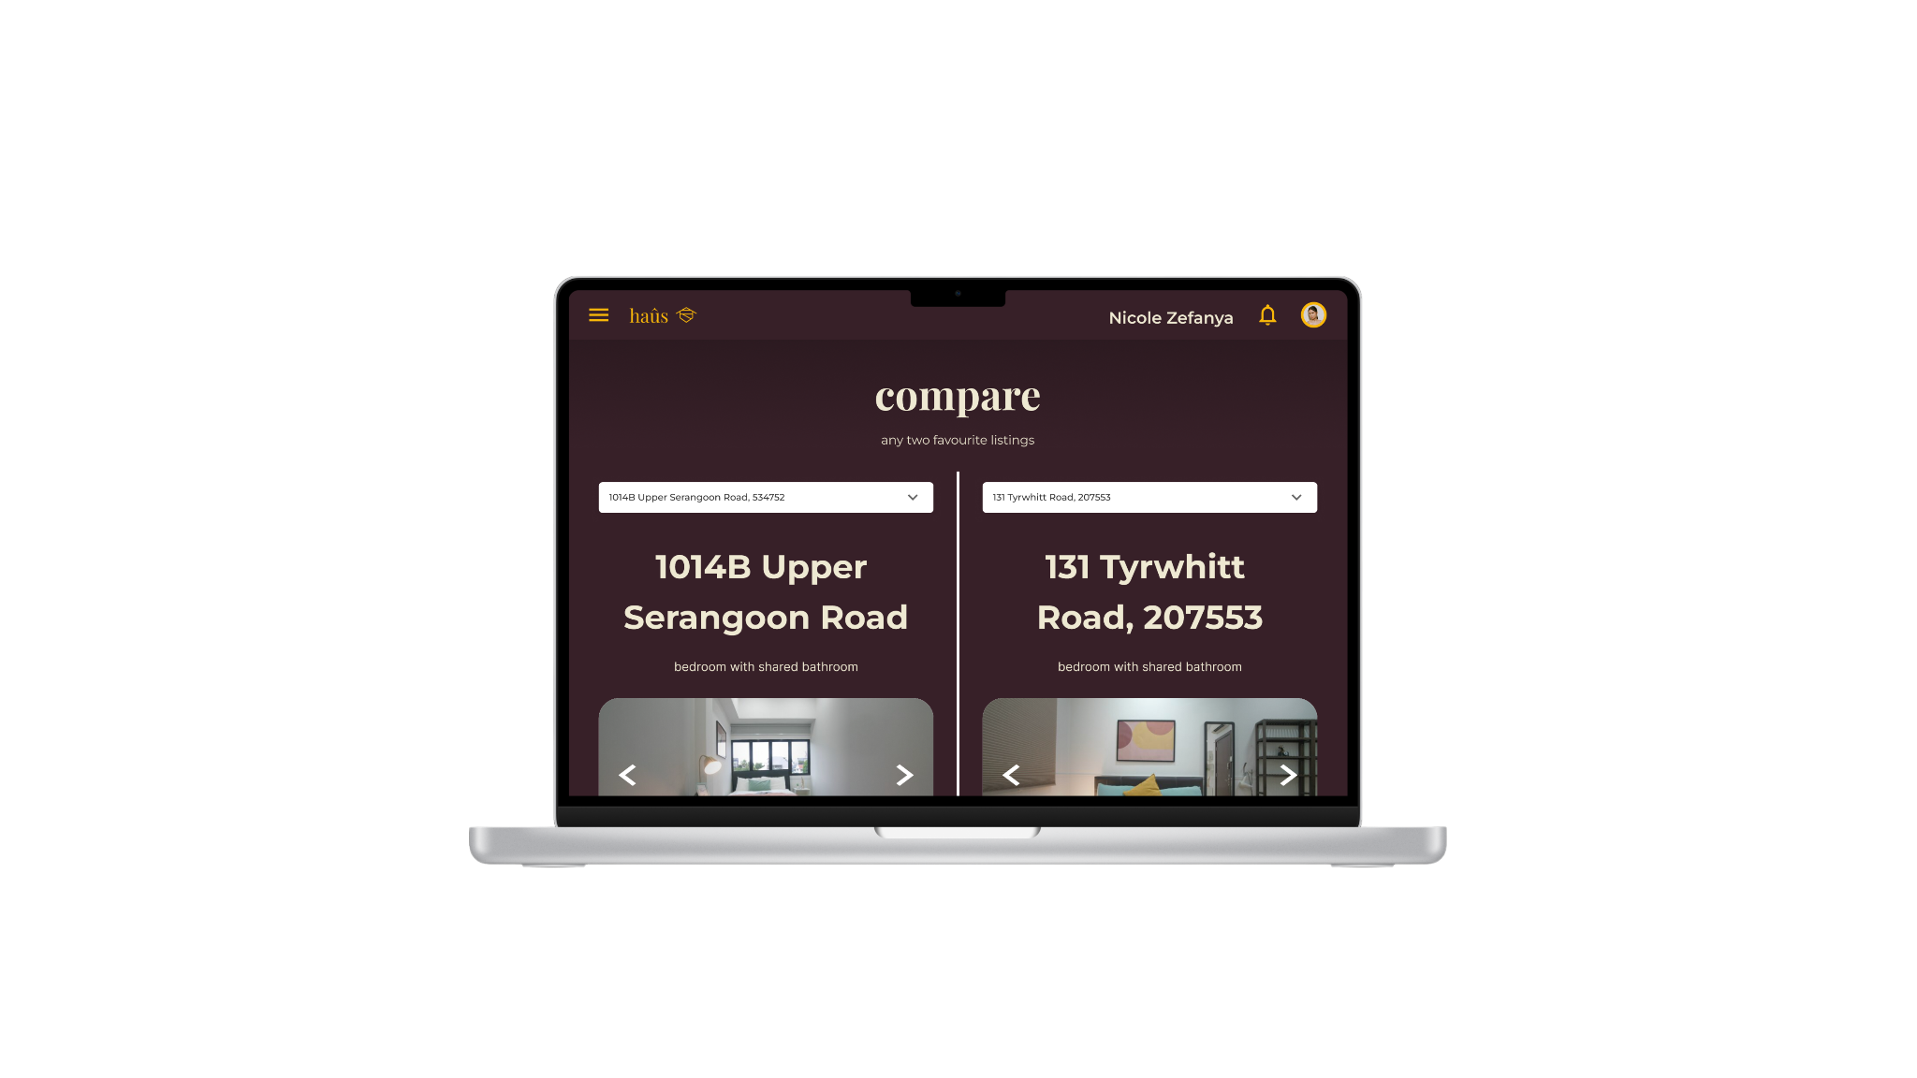
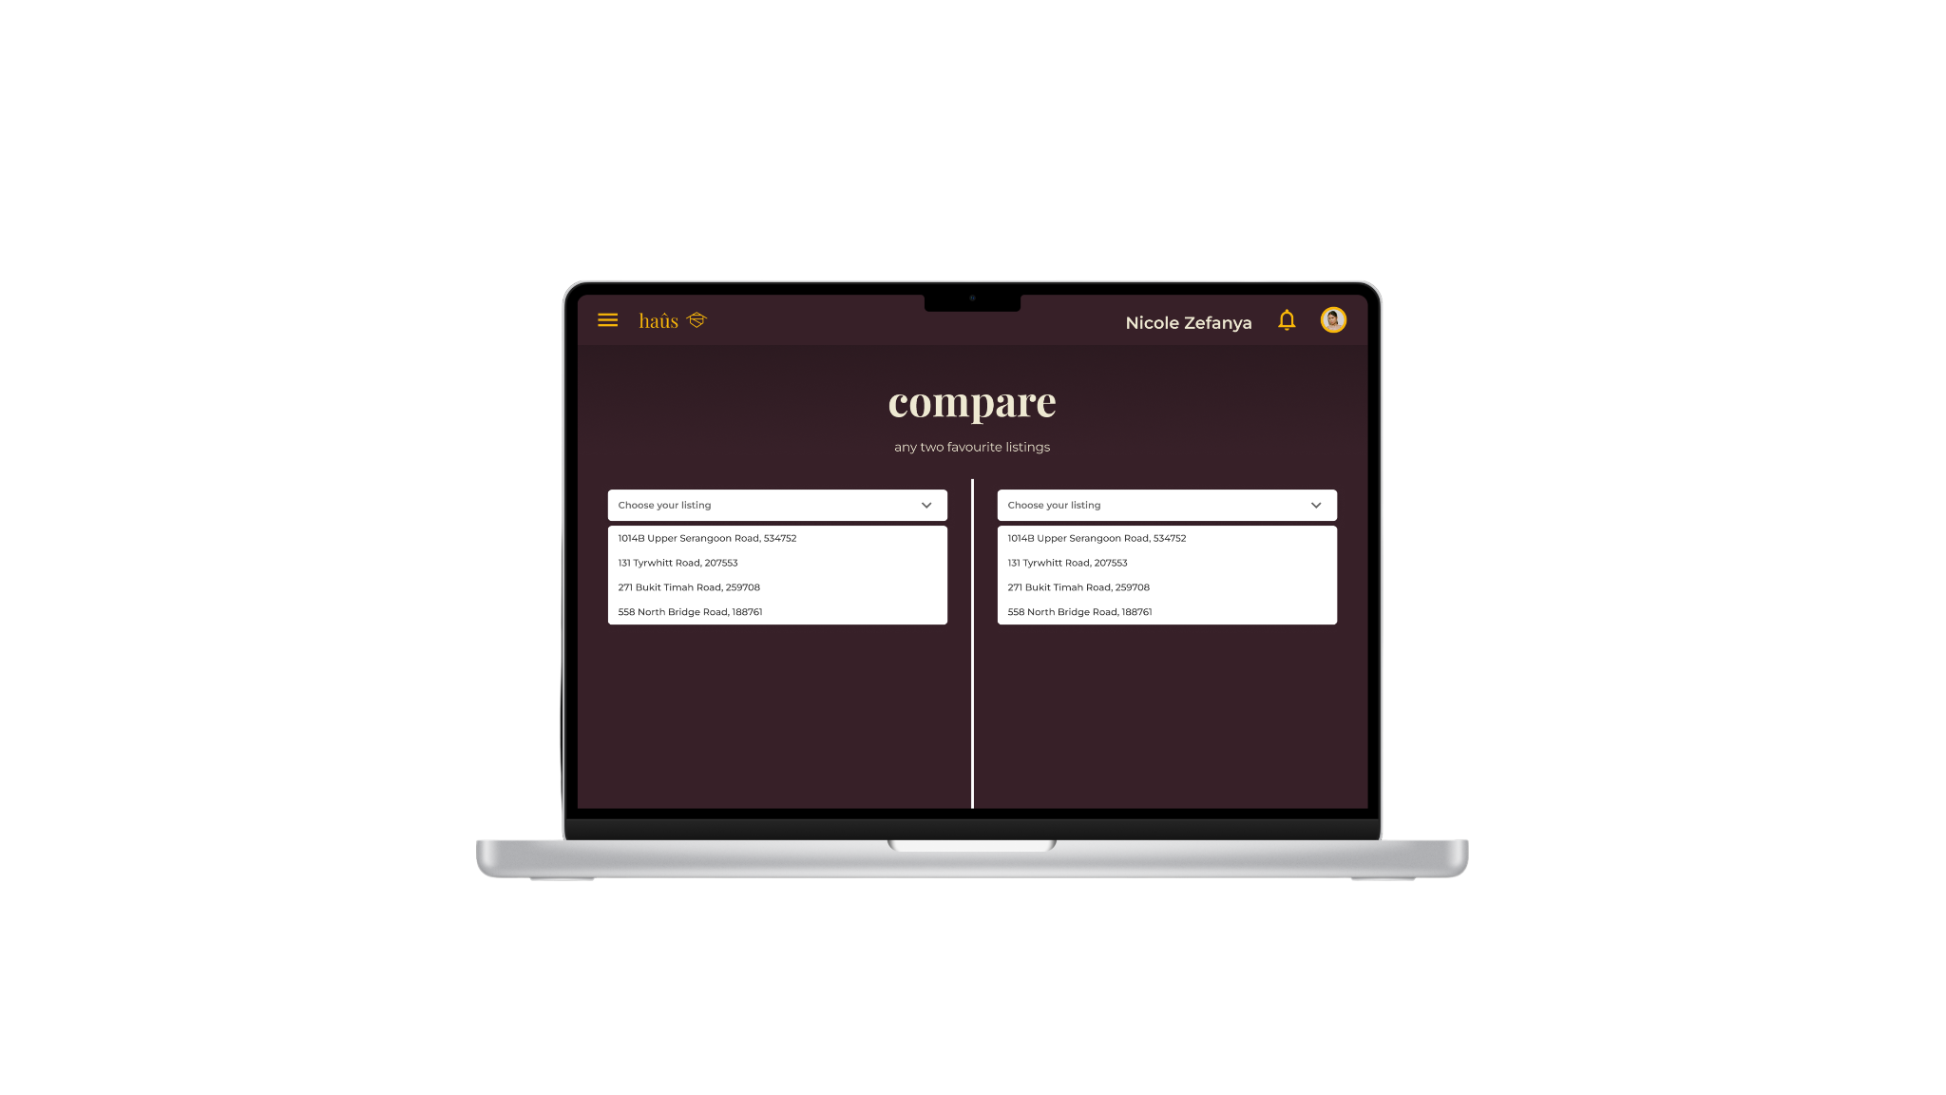
Comparison page
IDP G8T5 | haûs .

Slide 21
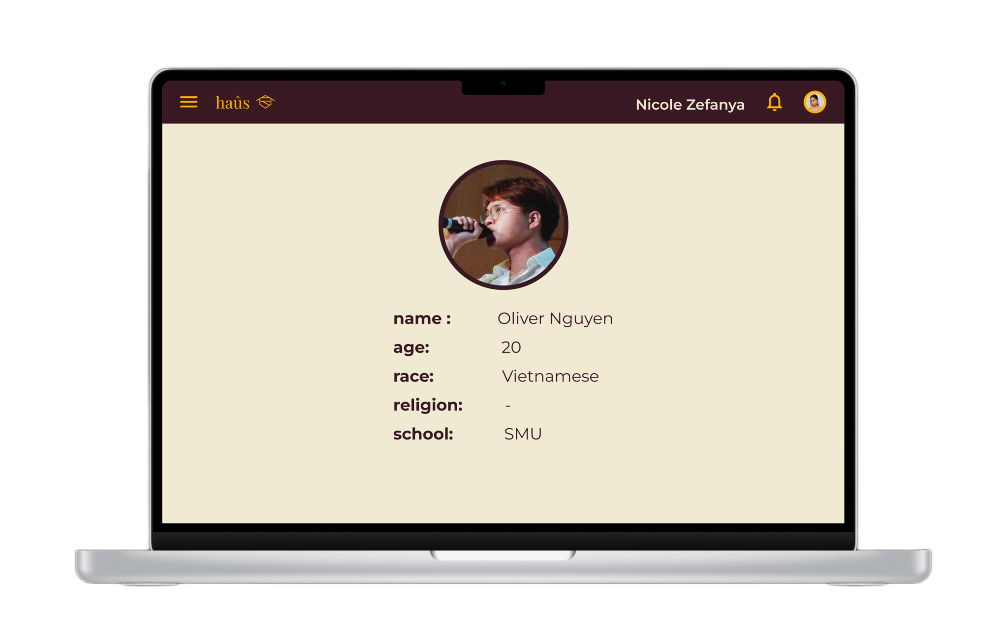
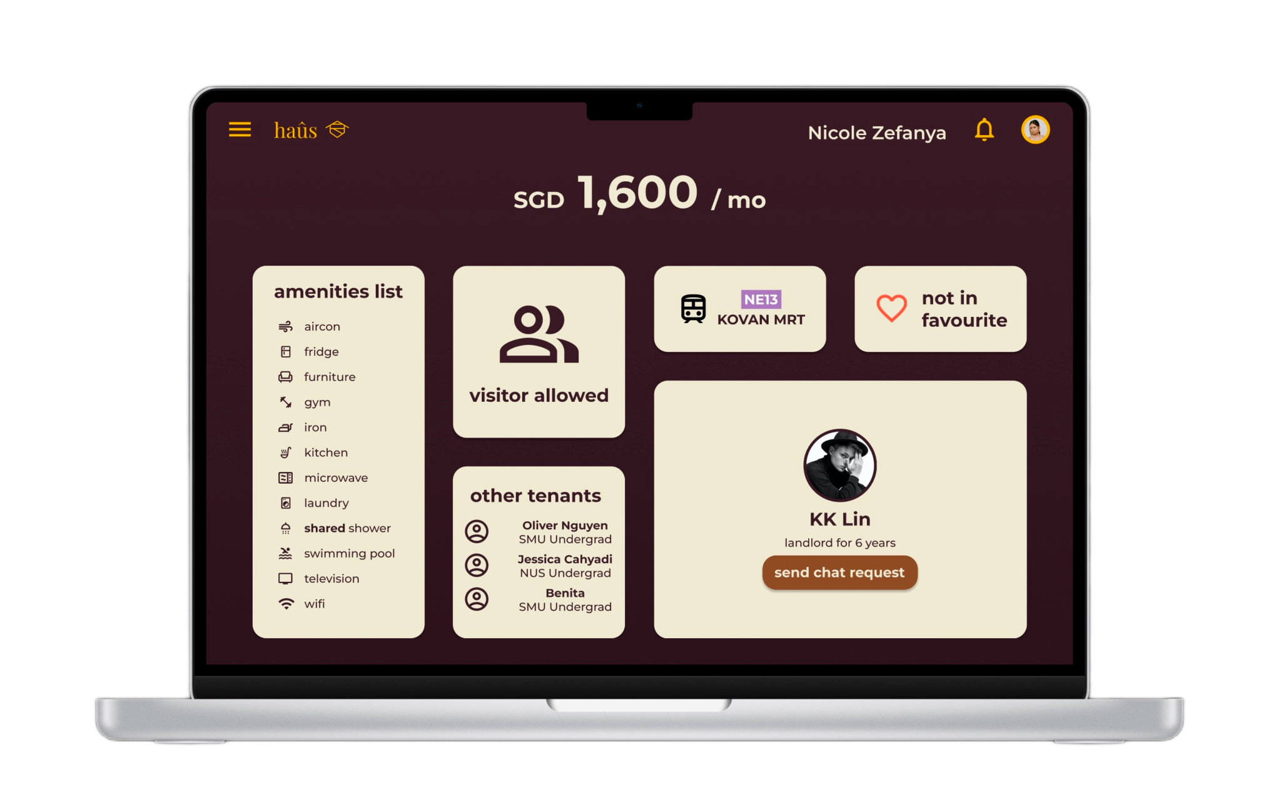
View other profiles
IDP G8T5 | haûs .

Slide 22

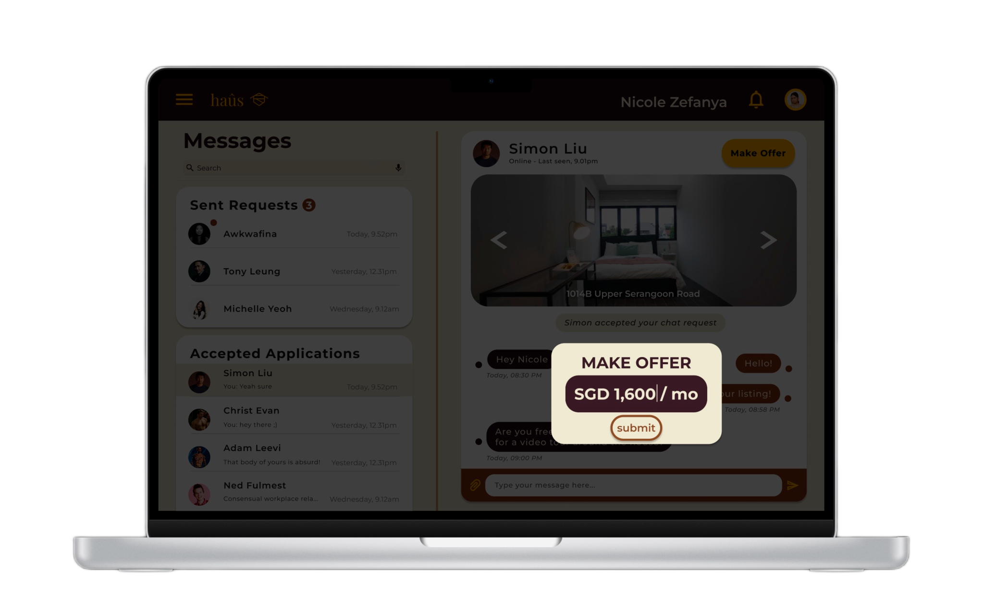
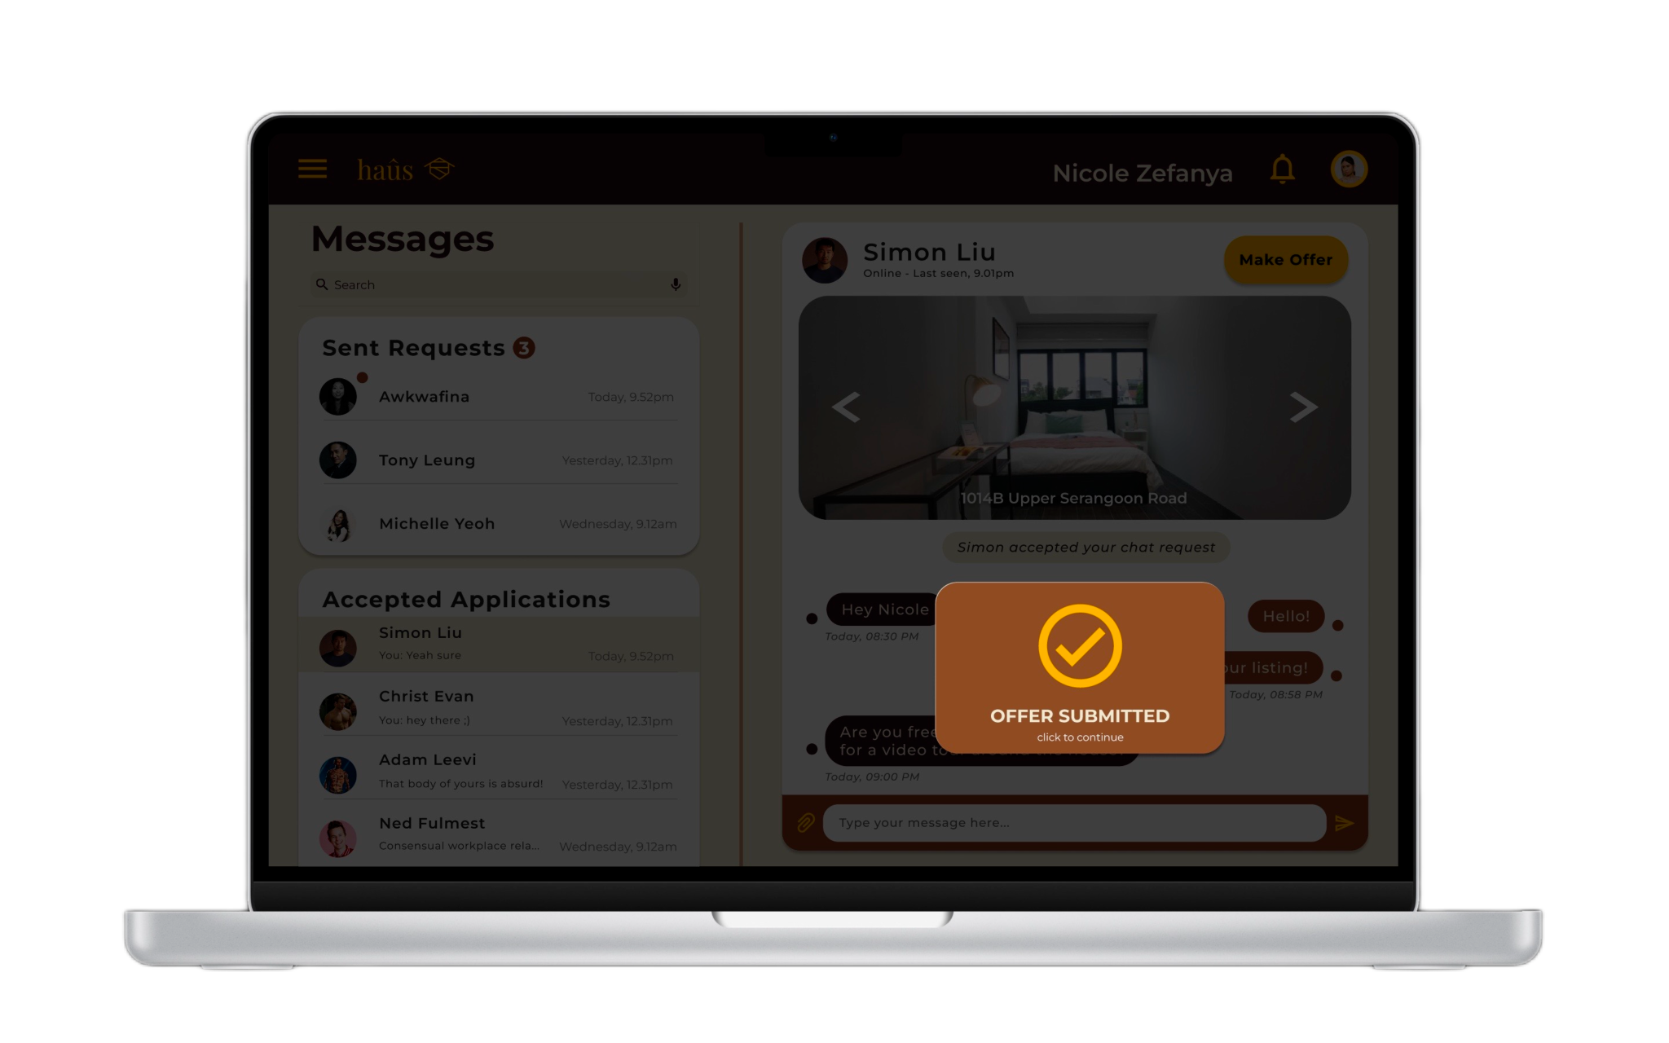
Chat & Make Offer
IDP G8T5 | haûs .

Slide 23
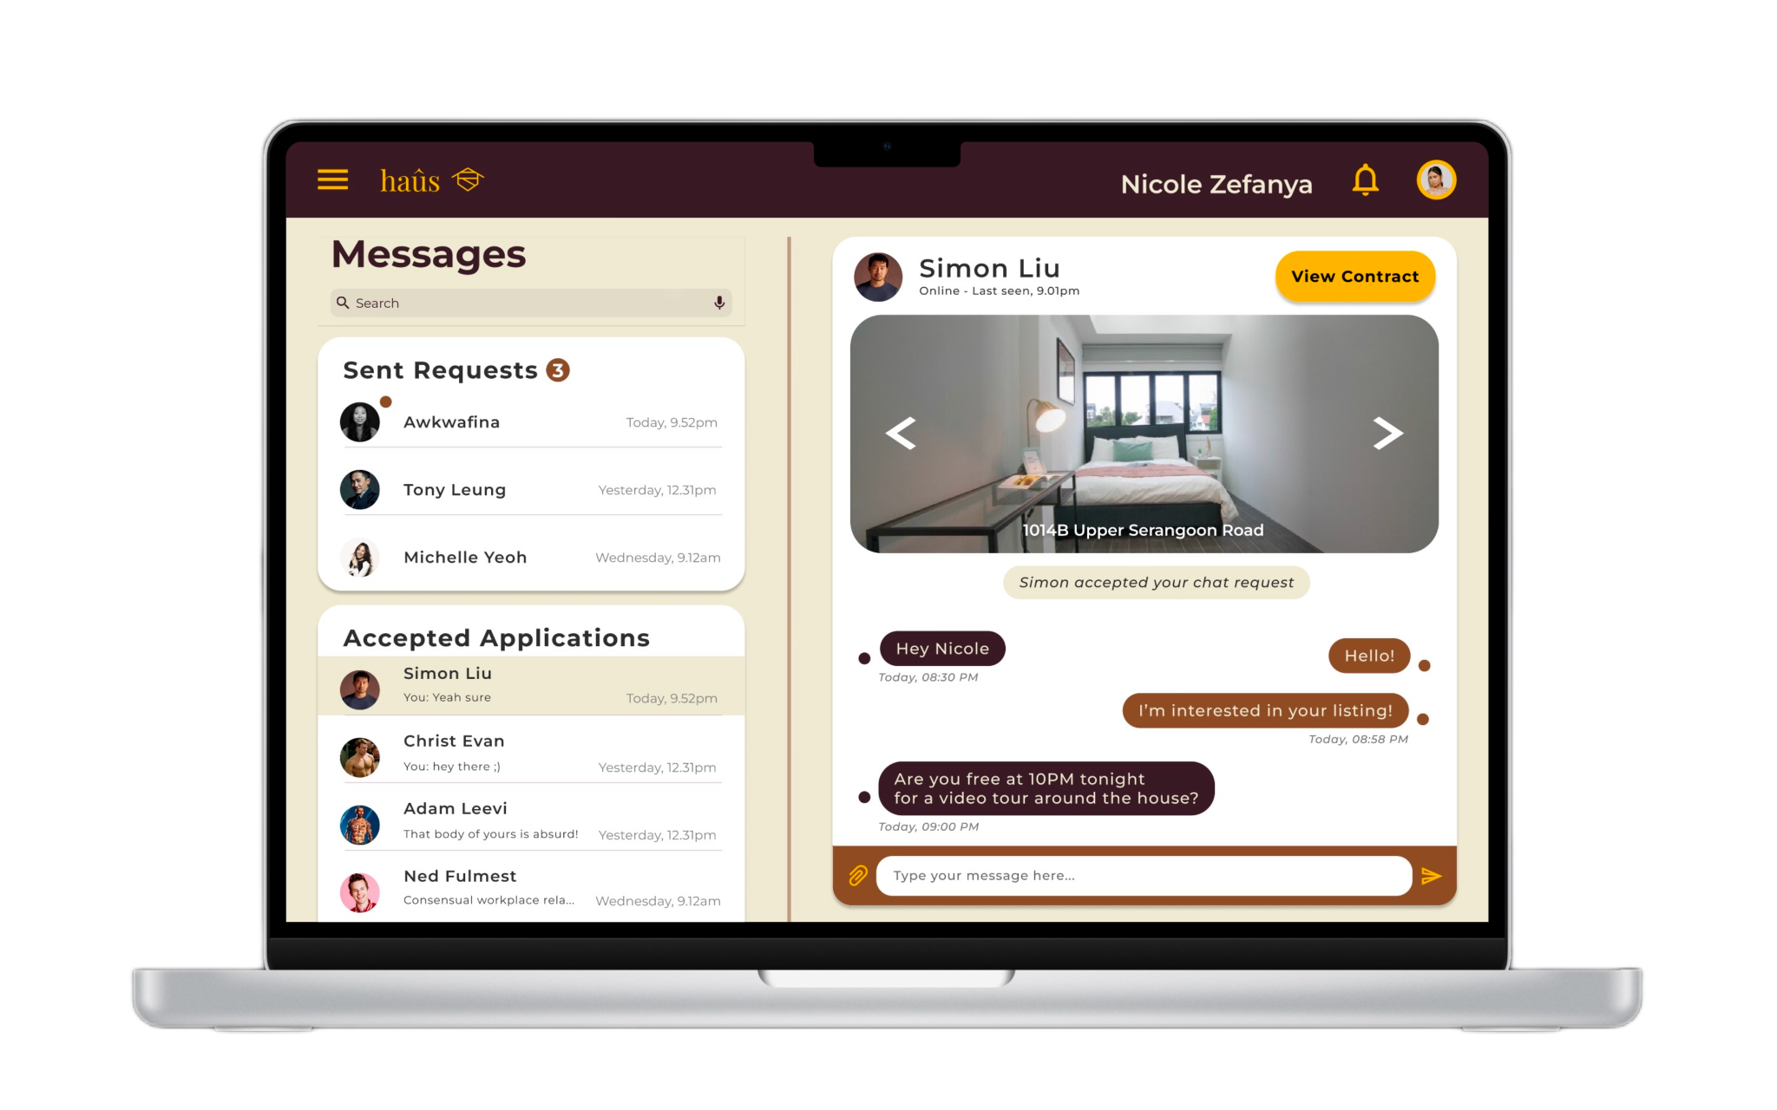

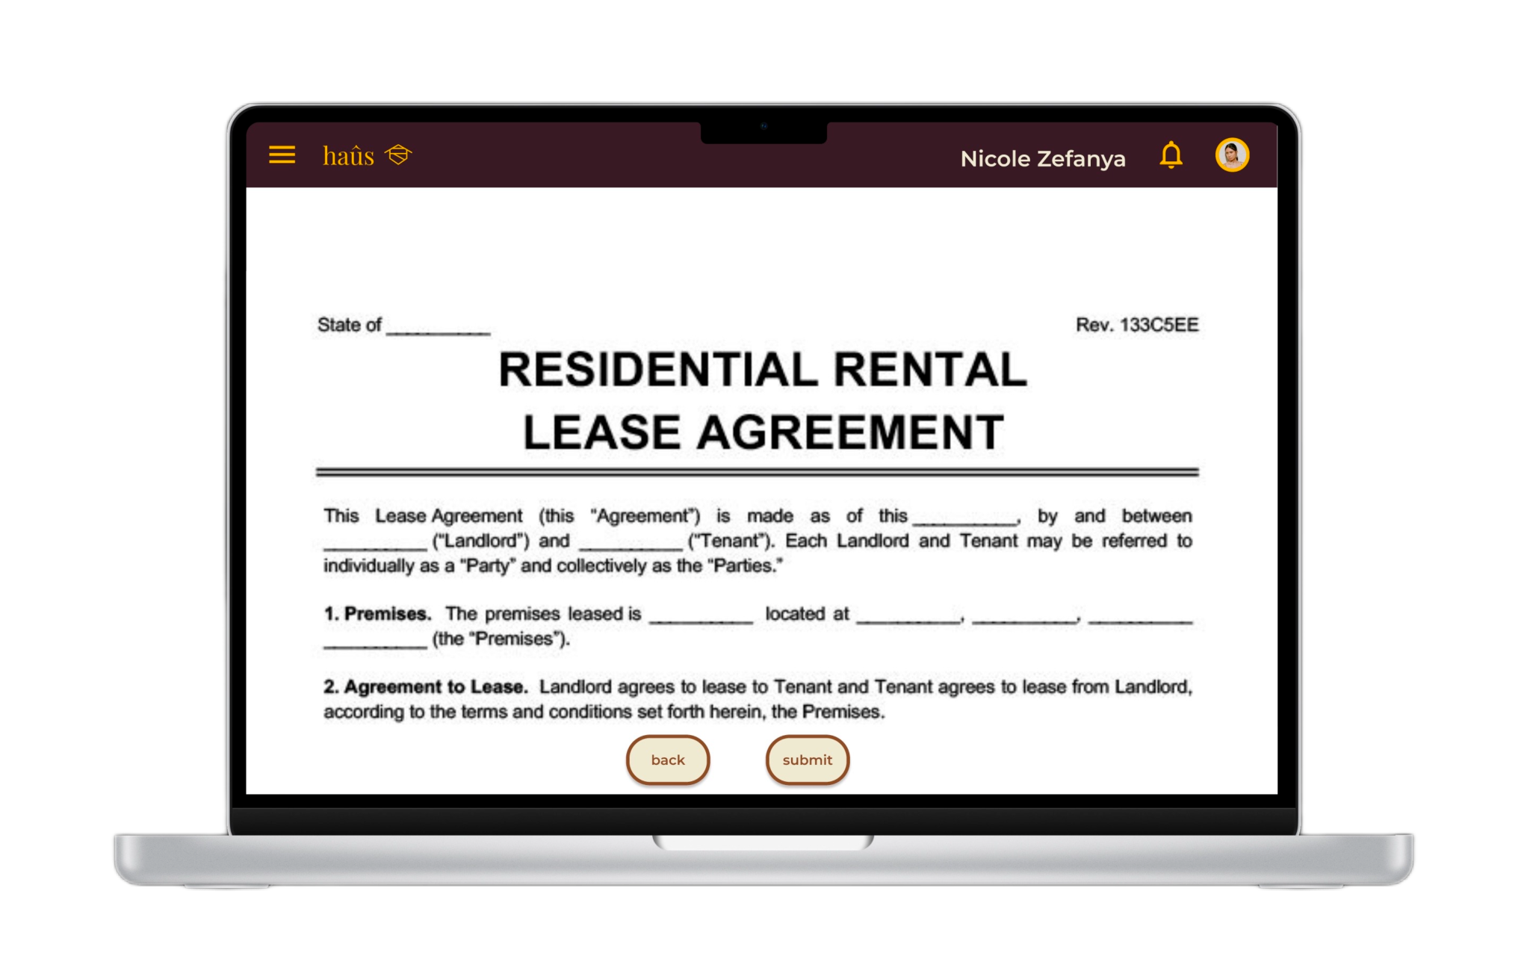
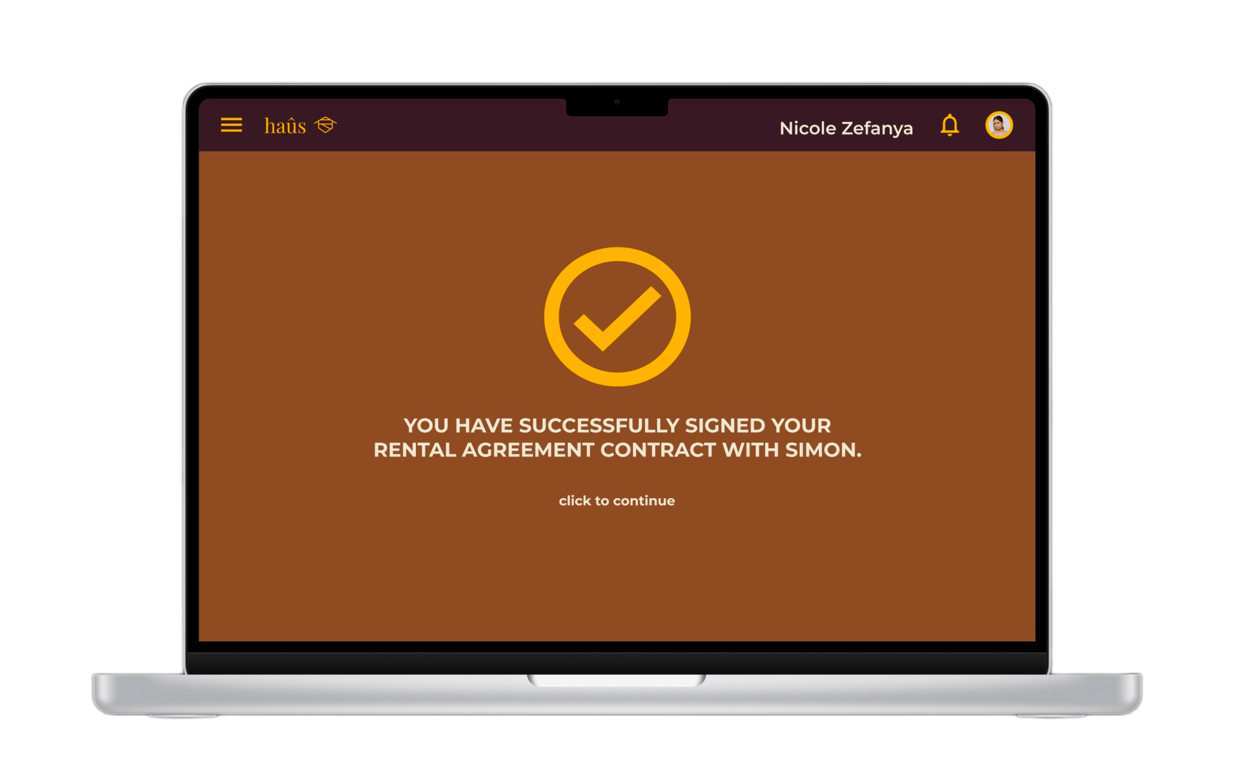
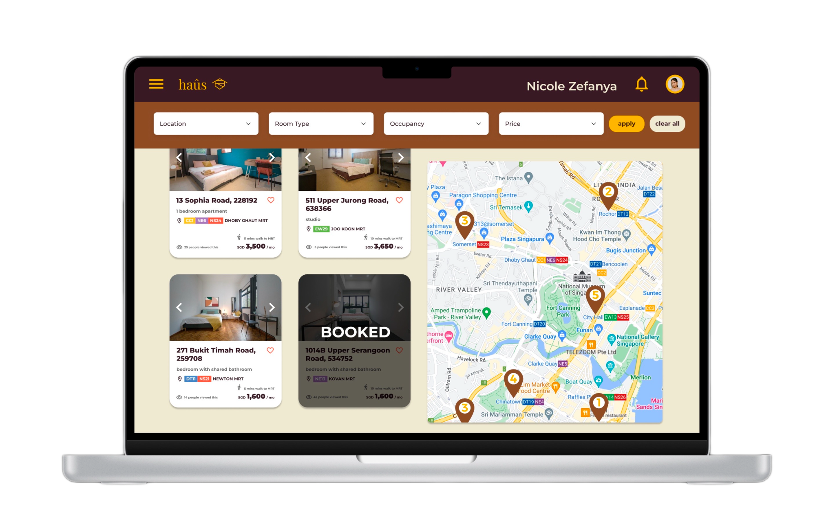
Contracts
IDP G8T5 | haûs .

Slide 24
Our Scenario
IDP G8T5 | haûs .

Slide 25
05
Evaluation
IDP G8T5 | haûs .

Slide 26

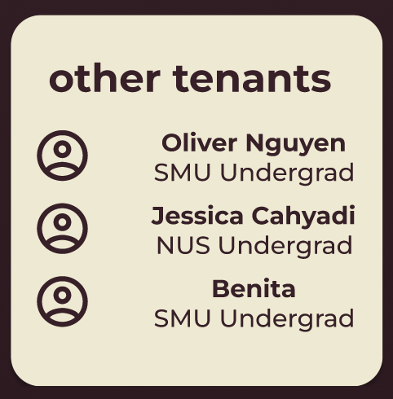
Our Experiment (A/B Testing)
IDP G8T5 | haûs .
Within-Subject Testing
A
co-tenants information are displayed in a timed carousel format
co-tenants information are displayed in a 1 page list
B
Notes:
For the experiment, A/B testing is carried out within subject. In A, co-tenants informations are displayed in a timed carousel format whilst in B, co-tenants information are displayed in a 1 page list. The motivation behind A is that it is more aesthetically pleasing, and does not overwhelm the end users with information while in B, is designed with the goal of fulfilling the need for community, where all information is provided directly to the end users at once, minimising confusion.

Slide 27


Our Data Collection
IDP G8T5 | haûs .
Population
random respondents of different ages, who are (1) international students, and (2) have used other housing websites.
Dependent Variables
Task Completion Time
Accuracy of Question Response
Notes:
For the experiment, we have identified the population to be: _slide_
2 types of data collection is carried out, including seeking for respondents through communication platforms such as telegram and whatsapp, as well as randomly approaching them in public(providing the device to do the experiment) and then conducting the experiment through Maze.
We are seeking to gain the numbers for the dependent variables we have identified for evaluation. For the task completion time, it will be analysed using the Wilcoxon test and the Accuracy of Question Response through the Fisher test.
Moving on,

Slide 28
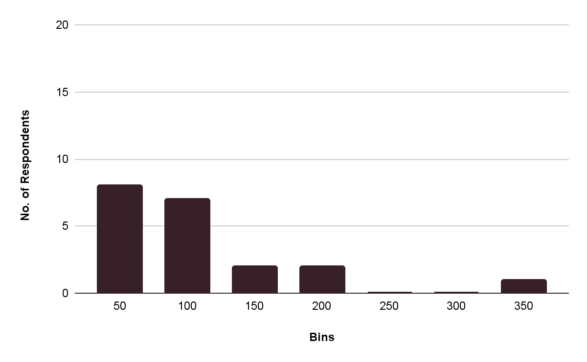
Wilcoxon Test (Task Completion Time)
IDP G8T5 | haûs .
Version A
Average Time Taken to complete the task in Version A = 80.2 seconds
Notes:
The Wilcoxon test is carried out due to the interval variables not being normally distributed. Additionally, since the experiment is carried out within subjects, the wilcoxon test is identified to be most appropriate for analysis of the dependent variable.
For the Wilcoxon test, we want to find and compare task completion time, and by running the test through R we found that the P value is 0.001045277, which is less than the confidence interval of 0.05. This implies that there is a significant difference between the task completion time of version A and B. Suggesting that version B requires less time and might be more intuitive to version. Next we will discuss a fisher test.

Slide 29
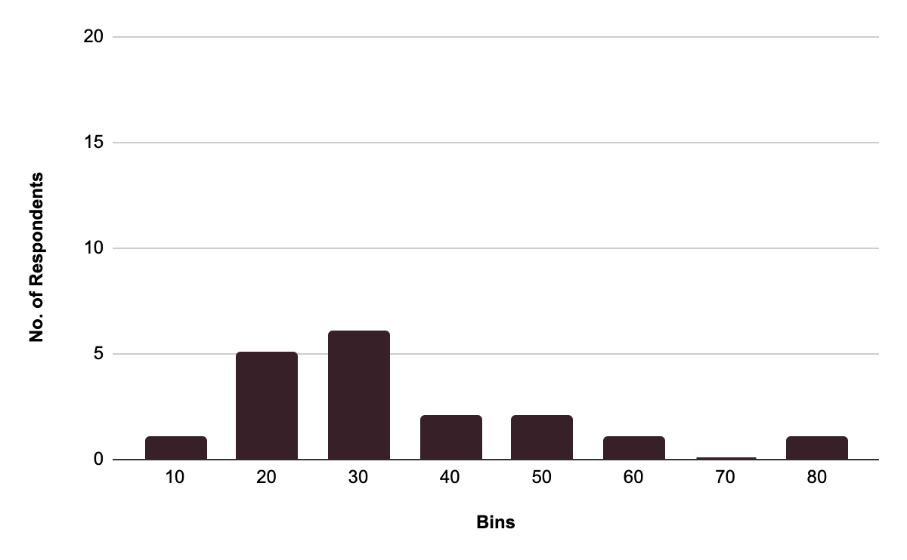
Wilcoxon Test (Time)
IDP G8T5 | haûs .
Version B
Average Time Taken to complete the task in Version B = 27.9 seconds
Notes:
The Wilcoxon test is carried out due to the interval variables not being normally distributed. Additionally, since the experiment is carried out within subjects, the wilcoxon test is identified to be most appropriate for analysis of the dependent variable.
For the Wilcoxon test, we want to find and compare task completion time, and by running the test through R we found that the P value is 0.001045277, which is less than the confidence interval of 0.05. This implies that there is a significant difference between the task completion time of version A and B. Suggesting that version B requires less time and might be more intuitive to version. Next we will discuss a fisher test.

Slide 30
Wilcoxon Test (Time)
IDP G8T5 | haûs .
Version A
Version B
p-value = 0.001045227 < 0.05 ..
There is significant difference between the mean of the time taken to complete the task in version A than that of version B.
Notes:
The Wilcoxon test is carried out due to the interval variables not being normally distributed. Additionally, since the experiment is carried out within subjects, the wilcoxon test is identified to be most appropriate for analysis of the dependent variable.
For the Wilcoxon test, we want to find and compare task completion time, and by running the test through R we found that the P value is 0.001045277, which is less than the confidence interval of 0.05. This implies that there is a significant difference between the task completion time of version A and B. Suggesting that version B requires less time and might be more intuitive to version. Next we will discuss a fisher test.

Slide 31
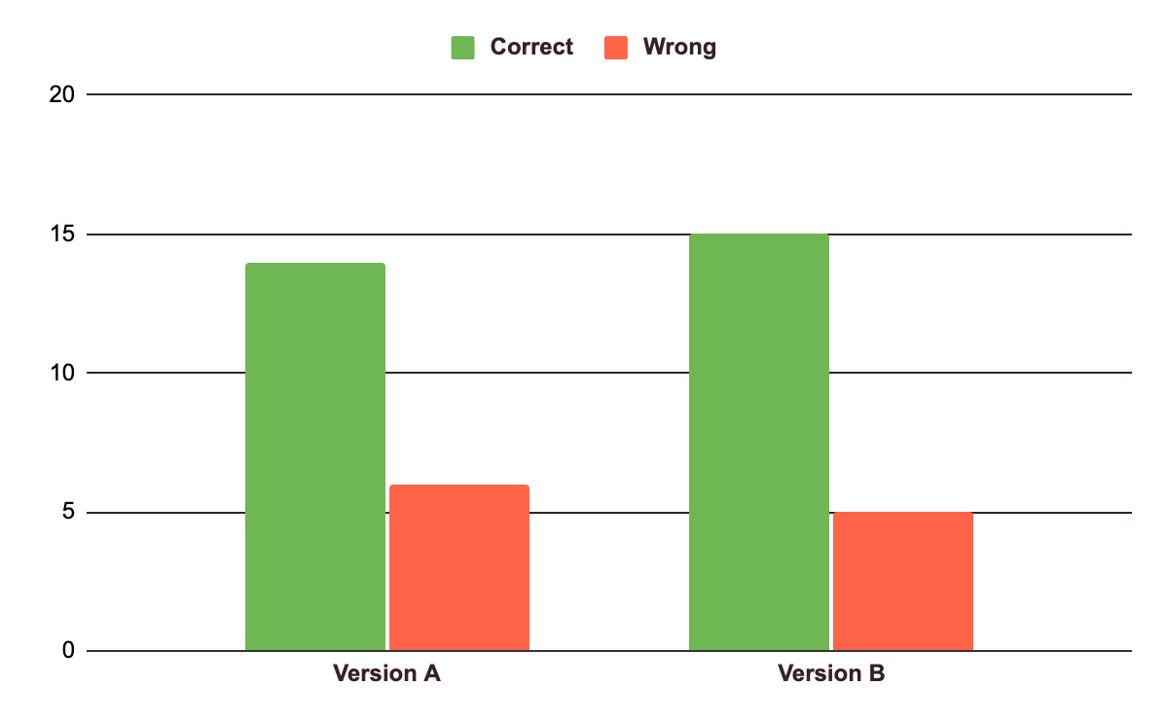
Fisher Test (Accuracy)
IDP G8T5 | haûs .
p-value = 1 > 0.05 . .
There is NO significant difference between in question response accuracy between version A and version B
Notes:
The Wilcoxon test is carried out due to the interval variables not being normally distributed. Additionally, since the experiment is carried out within subjects, the wilcoxon test is identified to be most appropriate for analysis of the dependent variable.
For the Wilcoxon test, we want to find and compare task completion time, and by running the test through R we found that the P value is 0.001045277, which is less than the confidence interval of 0.05. This implies that there is a significant difference between the task completion time of version A and B. Suggesting that version B requires less time and might be more intuitive to version. Next we will discuss a fisher test.

Slide 32
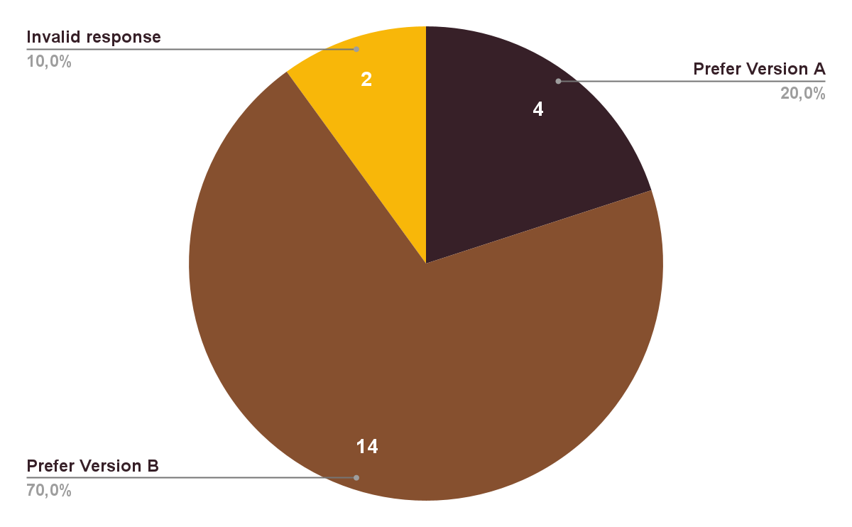
Binomial Test (Preference)
IDP G8T5 | haûs .
p-value = 0.03088279 < 0.05 . .
There is statistically significance for one version over the other version.
Prefer Version B over Version A .
Notes:
The Wilcoxon test is carried out due to the interval variables not being normally distributed. Additionally, since the experiment is carried out within subjects, the wilcoxon test is identified to be most appropriate for analysis of the dependent variable.
For the Wilcoxon test, we want to find and compare task completion time, and by running the test through R we found that the P value is 0.001045277, which is less than the confidence interval of 0.05. This implies that there is a significant difference between the task completion time of version A and B. Suggesting that version B requires less time and might be more intuitive to version. Next we will discuss a fisher test.

Slide 33
06
Reflection
IDP G8T5 | haûs .

Slide 34


Our team
IDP G8T5 | haûs .
Jesica Cahyadi
Oliver Nguyen
“IDP gave me a lot of things… like stress”
“I have never wanted to unalive myself so badly <3”
Notes:
The Wilcoxon test is carried out due to the interval variables not being normally distributed. Additionally, since the experiment is carried out within subjects, the wilcoxon test is identified to be most appropriate for analysis of the dependent variable.
For the Wilcoxon test, we want to find and compare task completion time, and by running the test through R we found that the P value is 0.001045277, which is less than the confidence interval of 0.05. This implies that there is a significant difference between the task completion time of version A and B. Suggesting that version B requires less time and might be more intuitive to version. Next we will discuss a fisher test.

Slide 35


Our team
IDP G8T5 | haûs .
Jessica Fiore
Justin Pansacola
“IDP gave me a lot of things… like stress”
“I have never wanted to unalive myself so badly <3”
Notes:
The Wilcoxon test is carried out due to the interval variables not being normally distributed. Additionally, since the experiment is carried out within subjects, the wilcoxon test is identified to be most appropriate for analysis of the dependent variable.
For the Wilcoxon test, we want to find and compare task completion time, and by running the test through R we found that the P value is 0.001045277, which is less than the confidence interval of 0.05. This implies that there is a significant difference between the task completion time of version A and B. Suggesting that version B requires less time and might be more intuitive to version. Next we will discuss a fisher test.

Slide 36
Our team
IDP G8T5 | haûs .
Benita Leonardi
Tan Jia En
“IDP gave me a lot of things… like stress”
“I have never wanted to unalive myself so badly <3”
Notes:
The Wilcoxon test is carried out due to the interval variables not being normally distributed. Additionally, since the experiment is carried out within subjects, the wilcoxon test is identified to be most appropriate for analysis of the dependent variable.
For the Wilcoxon test, we want to find and compare task completion time, and by running the test through R we found that the P value is 0.001045277, which is less than the confidence interval of 0.05. This implies that there is a significant difference between the task completion time of version A and B. Suggesting that version B requires less time and might be more intuitive to version. Next we will discuss a fisher test.

Slide 37
haûs
from international students to international students

